Slide 1
Big Mountain Ski Resort
Lift Ticket Price Optimization
Jack Thake

Slide 2
Problem Statement
Big Mountain Resort is currently charging $81 for an adult lift ticket. This places the ressort as a more premium option in its market segment.
However with the addition of a new chairlift, what facilities can the resort prioritize to support a higher ticket price?

Slide 3
Recommendation
Ticket prices can be increased by 118% to $95.87 with the addition of a new run extending 150 ft. below the current base of the resort.

Slide 4
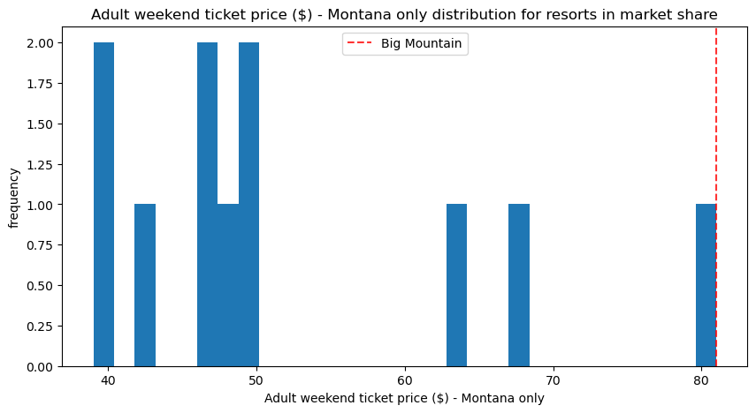
Big Mountain Resort VS In State Competitors
When Compared to its in state competitors, Big Mountain resort is the most expensive option.
However data analysis showed, the state did not have a major impact on a resorts ability to charge for higher ticket prices.
Big Mountain resort has always aimed to be a premium option in its market segment, it being the most expensive ticket in Montana does not indicate a ceiling on ticket price.

Slide 5
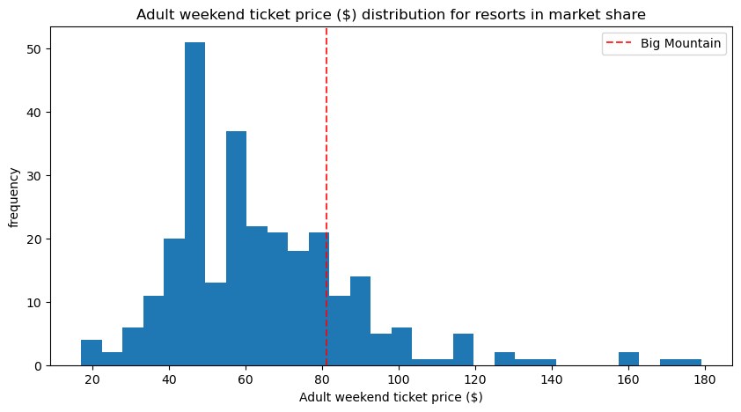
Big Mountain Resort VS Others in Market Share
When looking at Big Mountain’s overall position compared to nationwide ticket pricing it is clear that although Big Mountain is already charging a premium, there is room for increases in fairs.

Slide 6
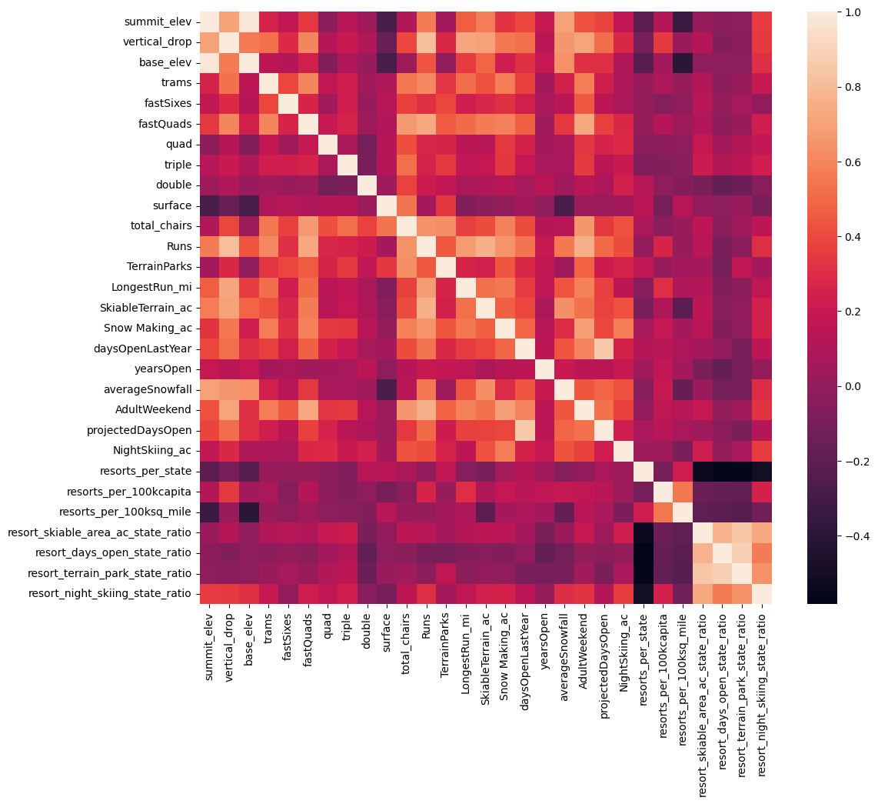
Correlations in the Data (nationwide)
From this figure it becomes clear that the major features of a resort in relation to ticket price are:
Number of fast four person chairlifts
Vertical drop from summit to base
Number of runs
Acres accessible by snow makers
Lighter color indicates higher correlation between attributes

Slide 7
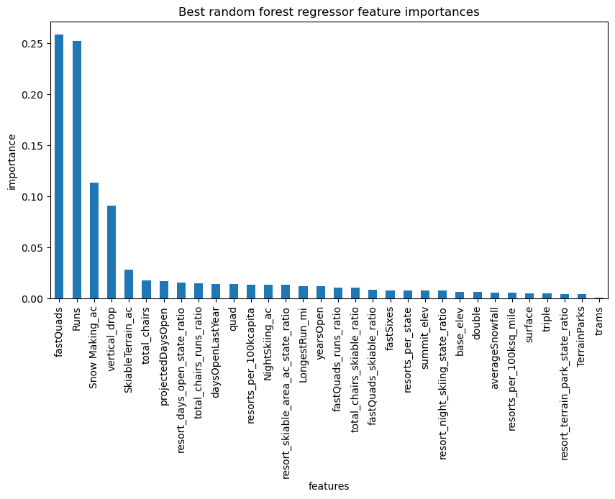
ML Model Important Features in Market Segment
The figure on the right shows the most important features of a resort in terms of ticket prices. Adding an extra run extending below the current base by 150 feet would increase:
Number of runs
Vertical Drop
Skiable Terrain

Slide 8
Conclusion
Adding an extra run, thereby extending the resorts base to summit elevation difference, skiable terrain and total number of runs would justify an increase in ticket fares to $95.87

